Slide 1
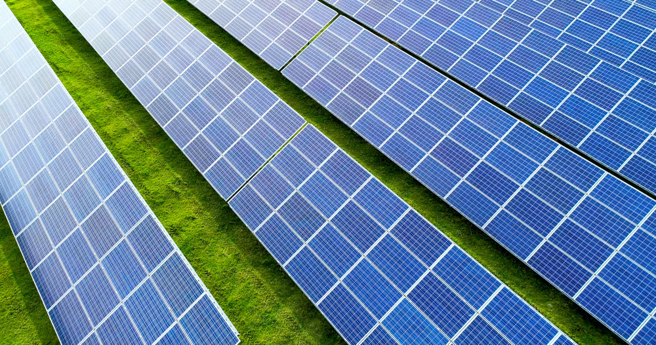

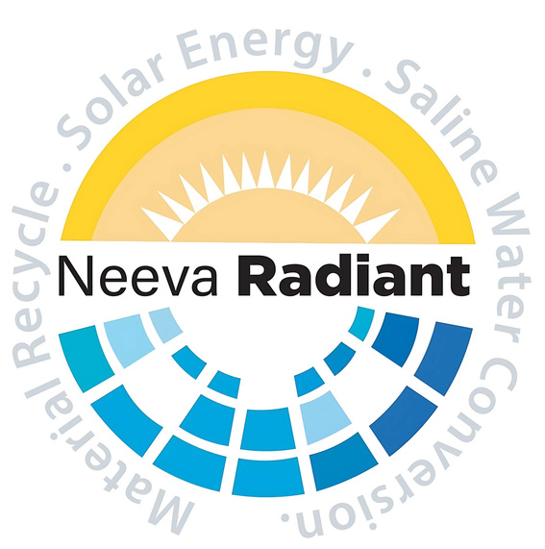
Revolutionizing Energy Access: Powering Progress with Open Access
POWER TO YOU!
New Age Power

Slide 2
Founded in 1984 by Mr. Krishna Reddy Yarabolu, our group began its journey in shrimp farming. Over the past 35+ years, we have evolved from humble beginnings into a fully vertically integrated aquaculture enterprise, covering the entire value chain.
Guided by a strong commitment to sustainability and innovation, we diversified into plastic recycling and value-added plastic manufacturing, producing essential aquaculture products such as shrimp seed packaging covers, aerator impellers, PE floats, and customized components—supporting circular economy practices and reducing environmental impact.
Today, our operations are powered by 500+ direct employees, supported by a strong ecosystem of consultants, technical experts, and strategic partners. With a legacy rooted in trust, responsibility, and long-term thinking, we continue to create shared value for farmers, employees, customers, and society at large.
GEEKAY GROUP

Slide 3
Empowering a Net-Zero Tomorrow Through Clean Energy Innovation
Our vision is to accelerate the global transition toward a sustainable future by anchoring our strategic investments in the powerful synergy of Solar Energy, Electric Mobility (EV), and Battery Energy Storage Systems (BESS). By fusing high-efficiency generation and advanced storage into a unified ecosystem, we aim to eliminate fossil fuel dependency and build resilient, localized power grids.
Driven by a steadfast commitment to sustainability, we engineer our projects to maximize long-term Environmental, Social, and Governance (ESG) impact. From implementing circular lifecycle practices in battery manufacturing to decarbonizing transit systems, our investments are designed to protect the planet while delivering clean, reliable energy for generations to come.
OUR VISION

Slide 4
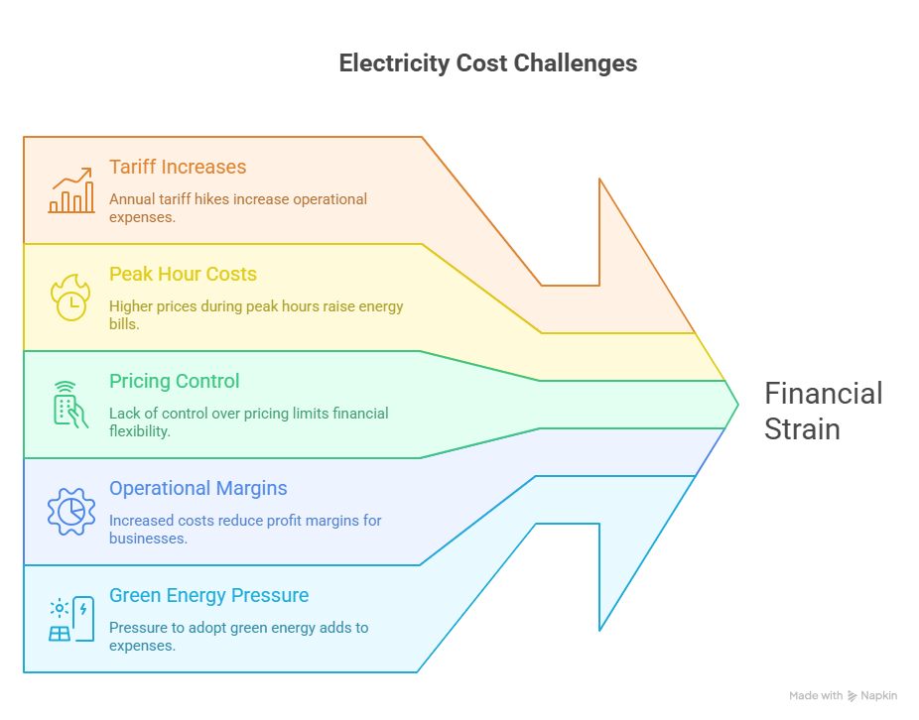
The Power Cost Challenge

Slide 5
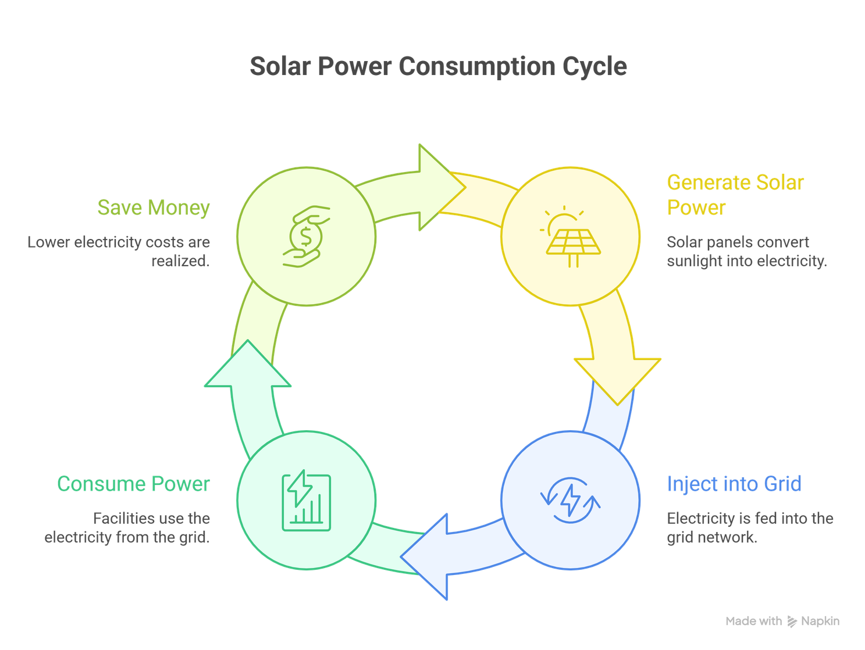
Our Solution: Open Access & Discounted Power
☀️ We Generate Solar Power
From our utility-scale solar power plant
➡️ Inject into Grid Network
Using approved Open Access framework
➡️ You Consume Power
At your facility through existing connection
➡️ You Save Money
Lower tariff than regular DISCOM rates
Zero Capex Mode Available
60 days onboarding

Slide 6
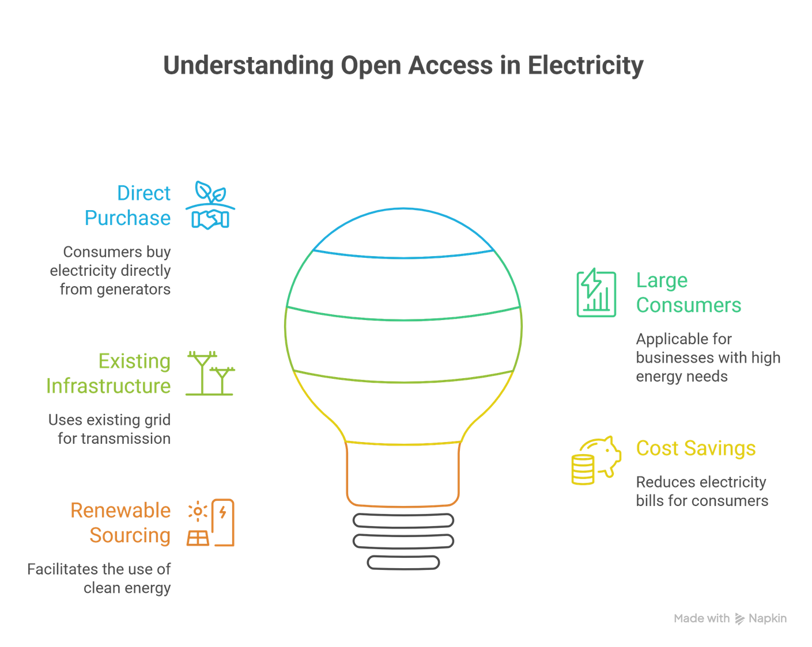
Typically >100 kW depending on state
What is Open Access

Slide 7
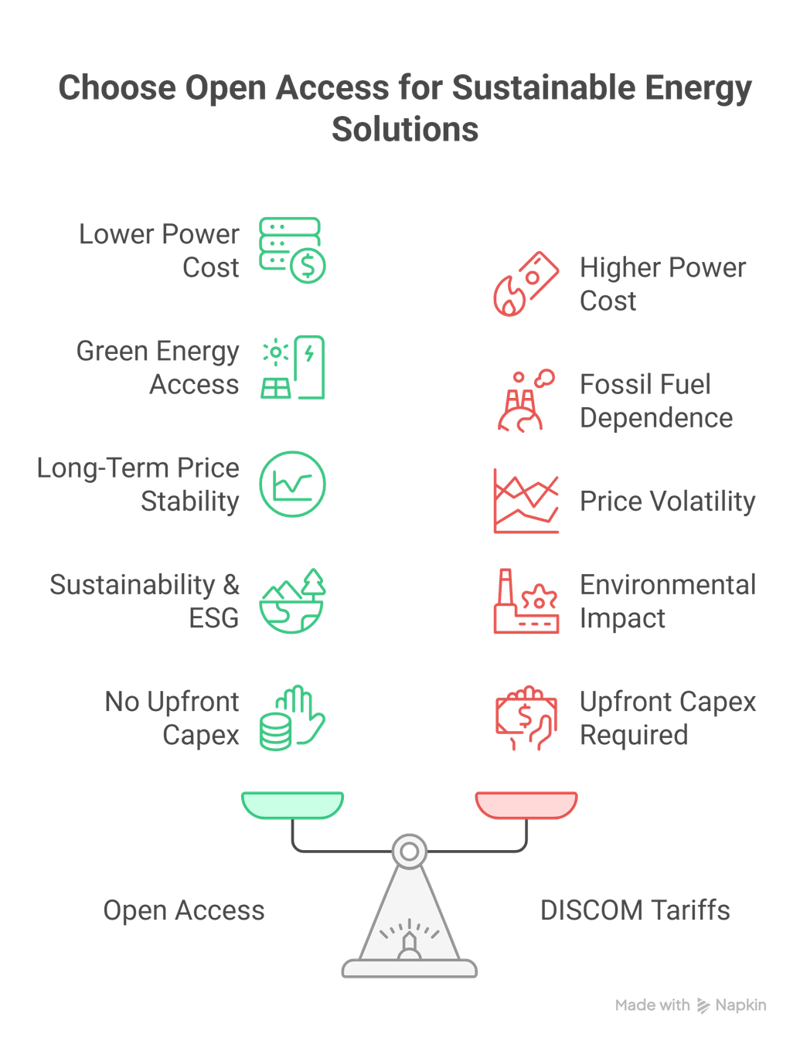
Why Open Access?

Slide 8
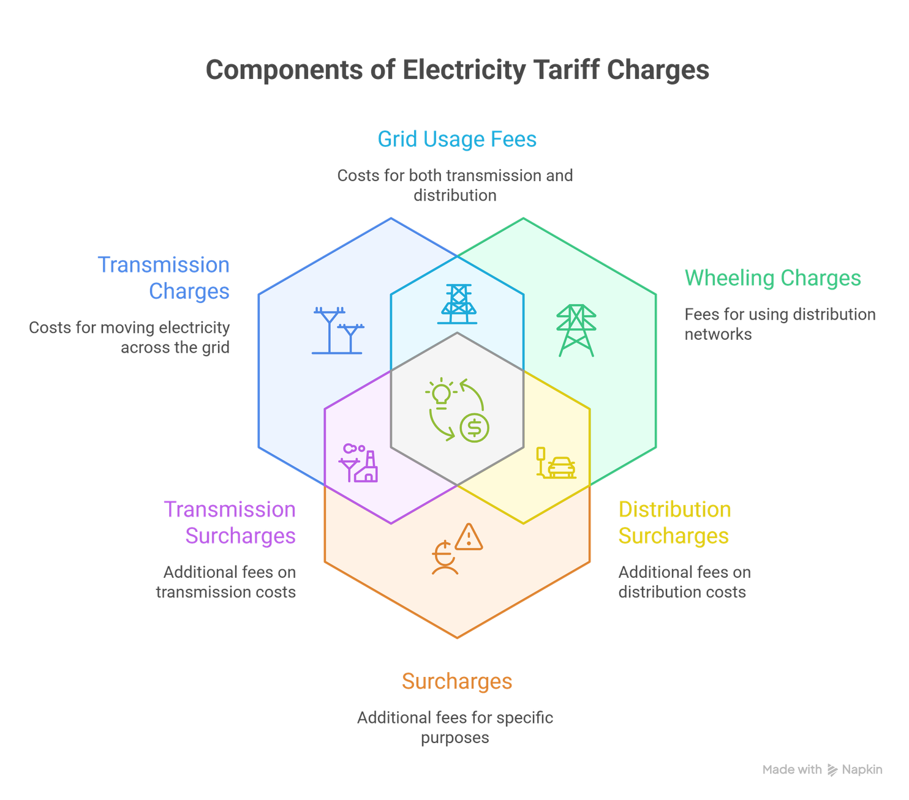
Charges in
Open Access
Banking Charges

Slide 9
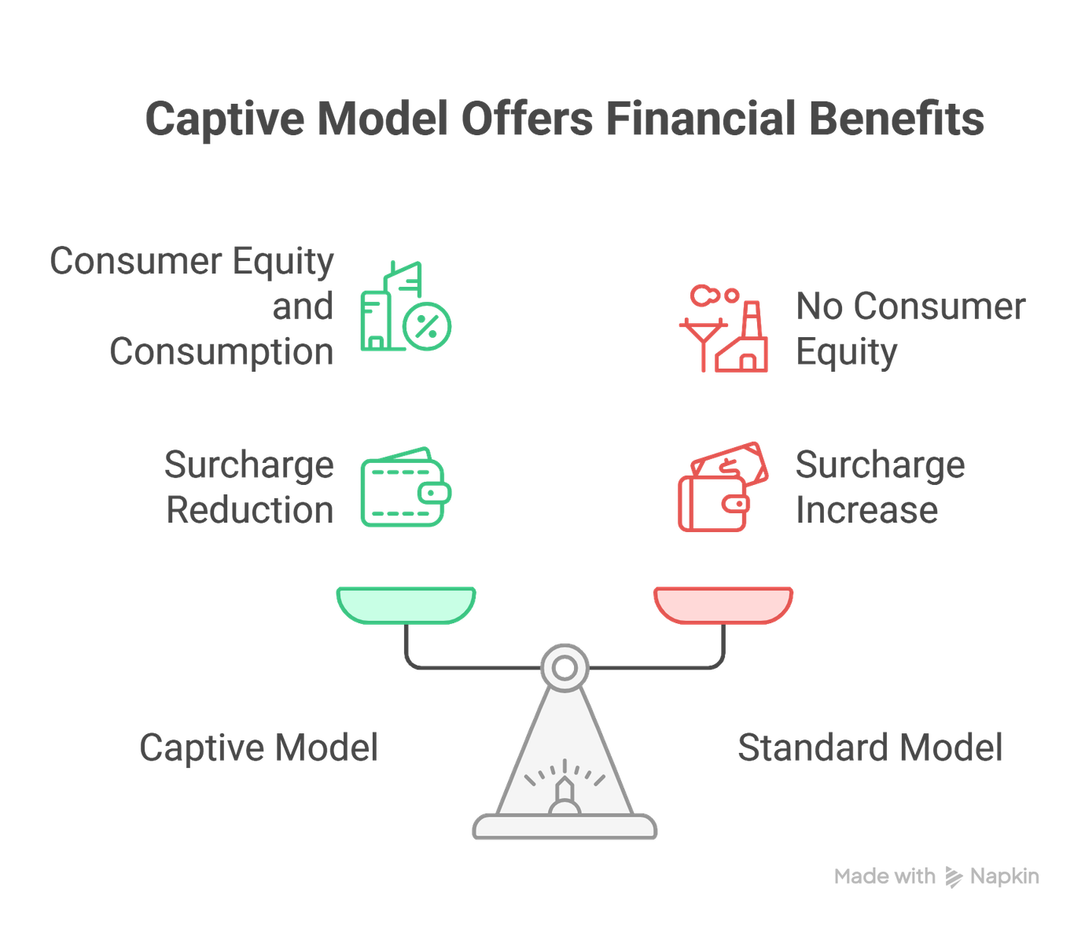
Open Access Captive
Captive Model:
  Consumer owns ≥26% equity in the power plant
Advantages:
  Significant reduction/elimination of:
    Cross Subsidy Surcharge
    Additional Surcharge
Zero Capex Model Available
(60 days onboarding)

Slide 10
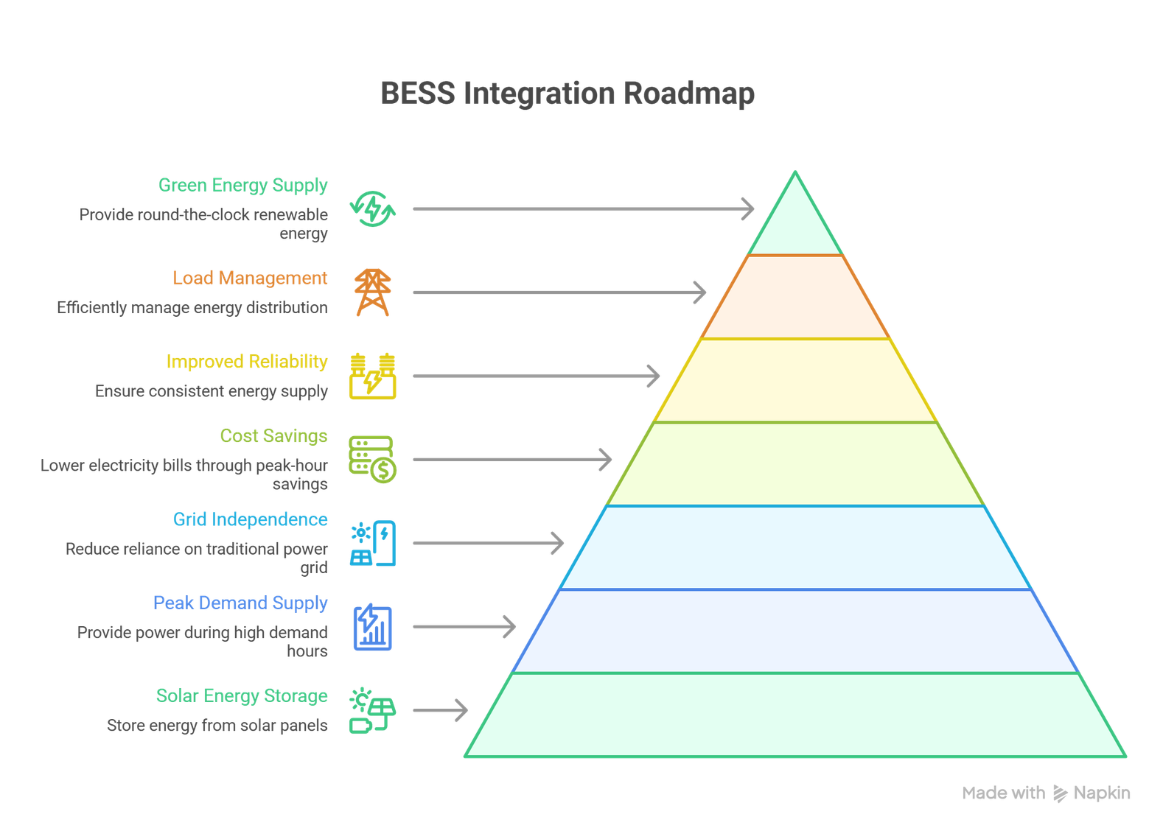
Future Road Map - BESS Integration
Why BESS?
  Store solar energy
  Reduce dependency on grid power
  Peak-hour supply (evening 6 PM – 10 PM)
  Improved reliability
  Better load management
  Green energy supply
  Genset costs?*

Slide 11
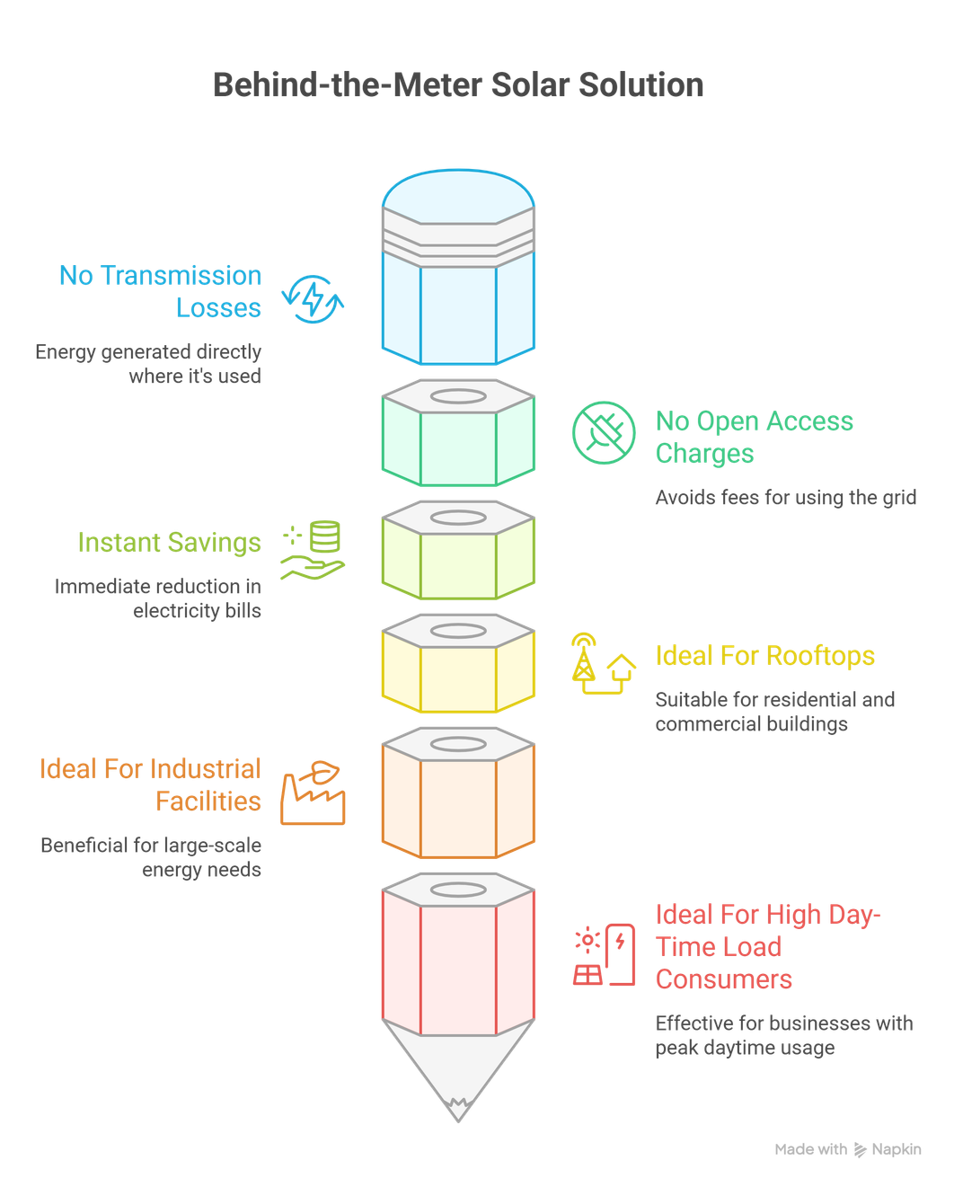
Behind the Meter Solution
What is Behind-the-Meter?
Solar system installed within the consumer's premises, on the customer's side of the electricity meter.
What are the advantages?
No transmission losses or open access charges with Instant savings
Who is it for?
Ideal for rooftops, industrial facilities, and high daytime load consumers

Slide 12
Let’s Power the Future Together

